Slide 1
PERFORMANCE APPRAISAL SYSTEMS.
360 degrees appraisal systems vs management by objectives.
Notes:
Welcome to our presentation today. We are going to look at the two different performance appraisal systems that can be used in an organization. The two approaches include 360 degrees appraisal systems and management by objective system.

Slide 2
360 DEGREES APPRAISAL SYSTEM.
Employee is evaluated on the basis of both technical considerations and also their behavior and character throughout the period (Karkoulian, S et al 2016).
Involves interviewing for feedback rating for the employees.
Feedback sourced from colleagues, customers and clients.
Different criteria are used to rate the employees.
Notes:
The system involves getting opinion regarding a specific opinion from those have contact with the employer. Apart from considering the technical skills and performance of the employees, their behaviour is rated throughout the period the individual in question has been in the service. The appraiser interviews their colleagues and other members of the staff. Feedback and opinion of the employee may also come from opinions from customers and clients.

Slide 3
Benefits.
It is an all round evaluation method.
Promotes self evaluation and individual improvement.
Management is able to make informed choices for delegation and promotion.
Enables an employee performance at the maximum level benefiting the organization (Crowson, J et al 2018).
Notes:
The strengths or benefits of this method especially over the rest of appraisal system is that it is all rounded and does not rate employee just based on one criteria different standards are used. This method promotes an opportunity for an employee to evaluate themselves and if possible make self improvement on their own. The management can use this method decide during delegation of roles and promotion since it’s a wider evaluation model. It also creates the right attitude for one to aim at performing beyond their limits (Crowson, J et al 2018).

Slide 4
Disadvantages.
excessive managerial oversight can prevent honest responses.
It can lead to emphasis on the negative feedback.
Sometimes it might not be an informed feedback method.
Lack of management support, the system falls apart.
Notes:
Besides the strengths of this method, it has some limitations in using it. Asking someone to comment about someone may lead to so much on the positive side and may not be specific, this makes the data skewed. Some interviewees may take this to settle grudges by giving false information. When the management gets to know about the individuals commenting about others may discourage people from participating or telling the truth. If the approach lacks interdepartmental collaboration may not be attractive, must be boosted by a reward system.

Slide 5
Best practices.
Survey questions should encourage constructive responses and provide an opportunity to say what some does right.
Coaching and create awareness of the benefits of giving honest feedback.
Anonymize those who give feedback in a system that is in line with culture of the organization.
Use a survey administrator to regulate the process of reviewing.
Notes:
To best reduce the limitations of this approach, it is important to use best approaches that will fill the existing gaps in the system. It is important for the survey questions to be designed in order for even are the good side of an employee. The employees also should be coached and sensitized on the benefits of giving honest feedback for improvement of the organization. The individuals who are interviewed should remain anonymous to prevent prejudice.

Slide 6
Management by objectives system.(MBO)
It determines how the goals and objectives of an employee are in line with those of the organization.
Management clearly spells out and defines the MBO goals to be used for appraisal.
It gives employees standards of self evaluation in their performance.
The objectives may be of three categories.
      Personal development objectives.
      Maintenance objectives
      Improvement objectives.
Notes:
This approach of perfomanace appraisal involves comparing the objectives guiding the employee with those of the organization and how the have been able to achieve them. The objectives to be used are prepared by the management and steps how to achieve them is spelt out. Employees are able to monitor how they are achieving for the organization. The objectives can be of the three categories.

Slide 7
Benefits of using MBO.
Promotes career development/growth.
It gives the employees a sense of identity with the organization.
Leads to improvement in performance.
Promotes responsibility and organizational culture.
Notes:
Use of this methods have various benefits based on its unique approach of evaluation. It enables an employee to develop their career for it relies so much on the skills and emphasizes on avenues for improvements. The employees relate with the organizational goals and this makes them feel they are part of it. Employee also has on opportunity to monitor how they are performing duties and make improvements where possible.

Slide 8
Disadvantages of MBO.
Sometimes it is not effective at the lower levels of the organization.
The is difficulty and shortcomings in forming joint objectives by unequal members of the organization (Islami, X. et al 2018).
It lacks flexibility in implementation.
It is pressure oriented.
Notes:
There is some shortcomings in the use of this method. The junior staff do not resonate with the objectives of the organization since they above their paygrades. Preparation of the objectives also is hard because involves unequal members of the organization and the communication may still seem to be downward. Incase of changes in the environment of the business or organization implementation may be difficult as they have no room for correction. It puts so much pressure on the employee to achieve goals in expense of quality, efficiency and their personal life.

Slide 9
overall purpose of performance appraisal.
Promotes self development of members of the organization.
Enables merit based compensation in the organization.
Statistics from such evaluation is used in monitoring performance of the organization.
It makes it possible to identify underperformers in the organization.
Notes:
Both of the appraisal systems enables achievement of goals of the organization as well as setting a reputable organizational culture. Appraisal promotes individual employees to develop themselves beyond their limits. It also makes the organization to development of a system to reward hardworking employees on merit basis. Statistics may also be used to determine the progress of the organization. Underperformers of an organization can be identified for proper decision making to retain or terminate their services.

Slide 10
Differences.
MBO consumes less time compared to the 360 degree feedback.
MBO evaluates employees on the basis of the organizational goals only but 360 degree is all round.
360 degree feedback requires feedback from colleagues, customers and clients while MBO assessment is done by supervisors.
Notes:
The differences between the two appraisal methods is broad and comparisons should be done which is the best to use in the organization. MBO consumes less time because it is more specific rather than 360 degree feedback system whose process is long. Employees in an organization are based on different parameters including individual character while the MBO only considers the achievement of the organizational goals and objectives.

Slide 11
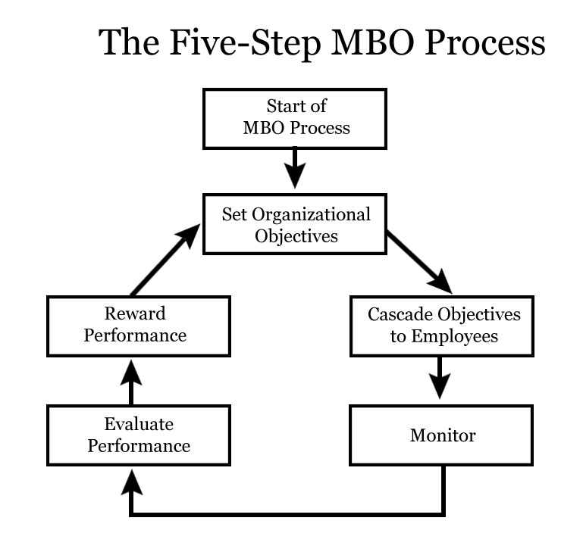
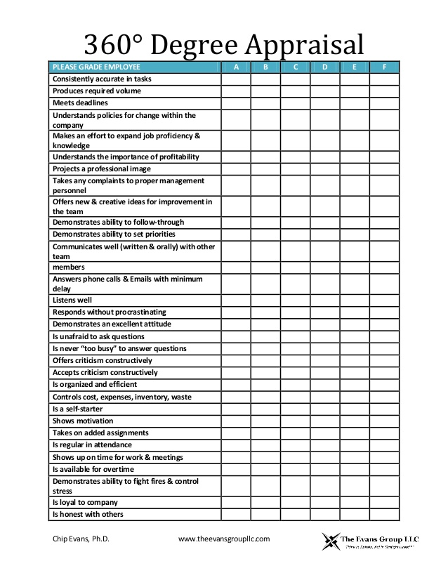
Examples.

Slide 12
References.
Crowson, J., Dagerath, J., Piedra, E., & Uttakalla, S. (2018). Performance Appraisal for Multinational Corporations.
Karkoulian, S., Assaker, G., & Hallak, R. (2016). An empirical study of 360-degree feedback, organizational justice, and firm sustainability. JournaI
slami, X., Mulolli, E., & Mustafa, N. (2018). Using Management by Objectives as a performance appraisal tool for employee satisfaction. Future Business Journal, 4(1), 94-108.l of business research, 69(5), 1862-1867.

